Slide 1


Amazon Customer Review Analysis

Slide 2
Outline
Problem Statement
Content
Analysis Tasks
POS tagging
Lenovo wants to analyze customer reviews on their product in order to evaluate the product and develop product pipeline.
Data set contains sentiment and review columns.
Topic Modeling using LDA
Topic Interpretation

Slide 3

Problem Statement
Lenovo has launched their budget smartphone in the Indian market and wants to understand the VOC (voice of the customer) on the product. This information will be used to evaluate the product and provide insight and direction for developing the product pipeline. The client wants to highlight aspects of the product that customers really care about. A leading e-commerce website will be used to analyze product reviews by customers.

Slide 4
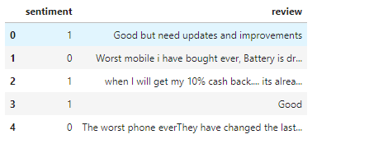
Content
Sentiments: For sentiment against the review; 4,5 stars reviews are positive, and 1,2 stars are negative.
Reviews: The main text of the review.
Below is a brief view of the dataset.

Slide 5

poS Tagging

Slide 6


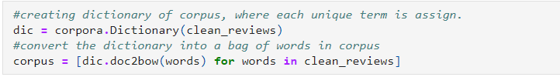
Pos tagging

Slide 7

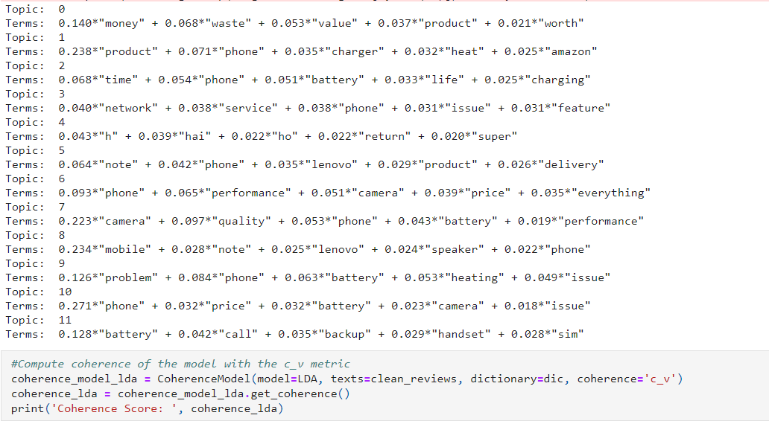
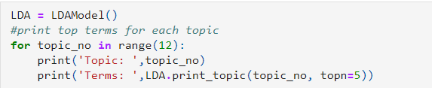
Topic Modeling

Slide 8

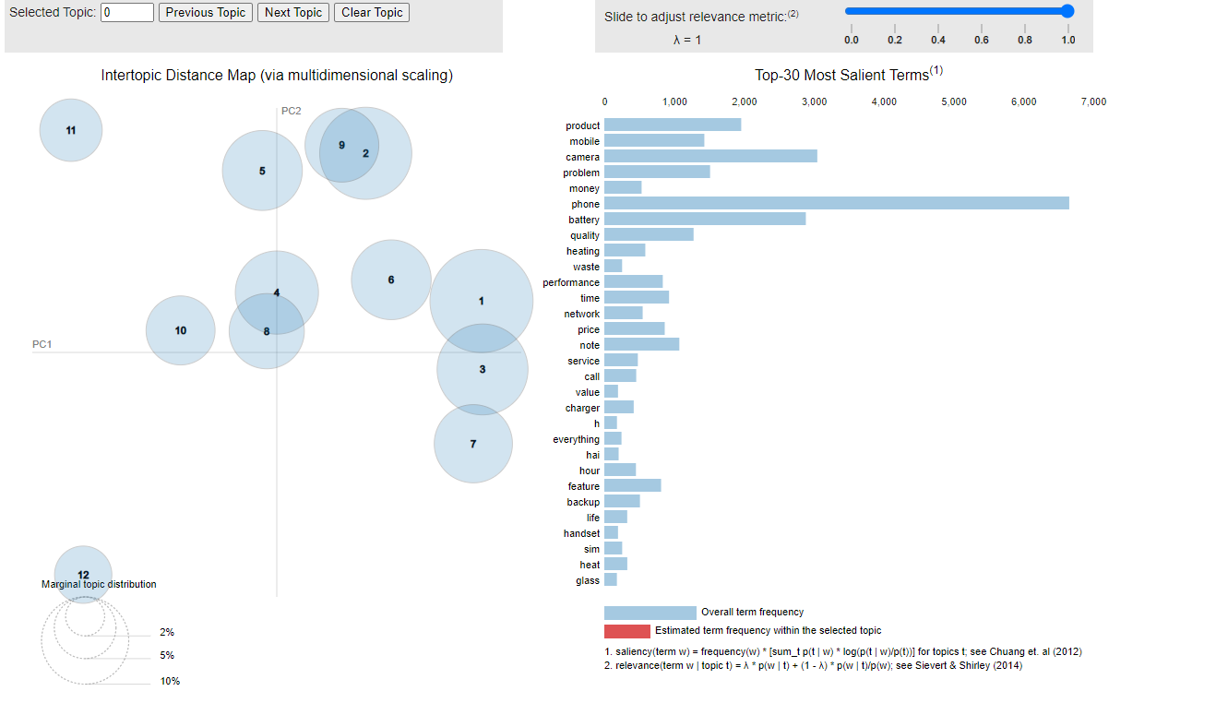
Intertopic Distance Map

Slide 9
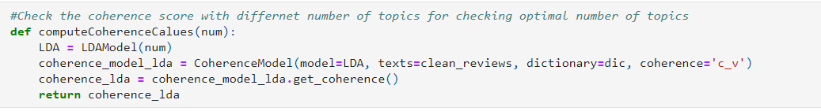
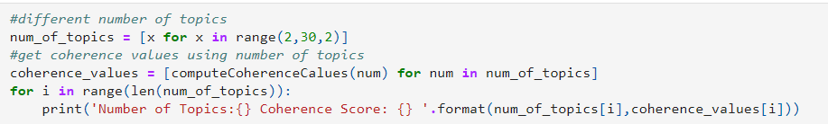
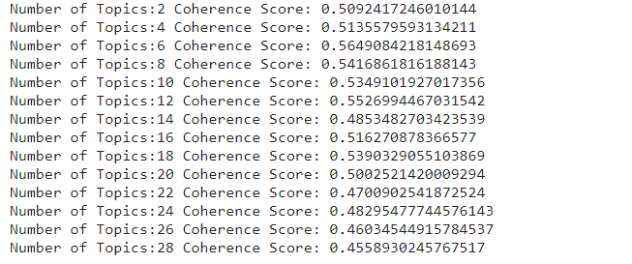
Topic Modeling

Slide 10
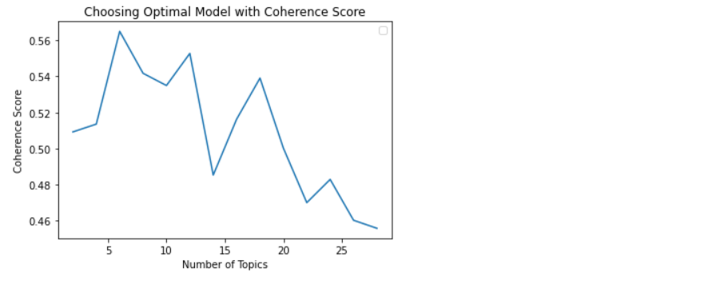
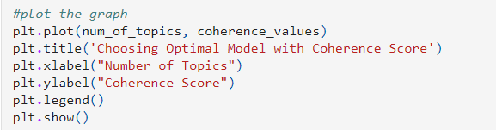
Optimal model with coherence score

Slide 11
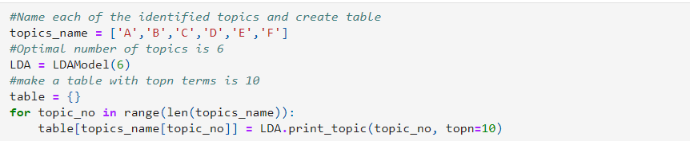

Topic Interpretation

